Slide 1
Amazon Product Ratings
PINAK SHOME

Slide 2
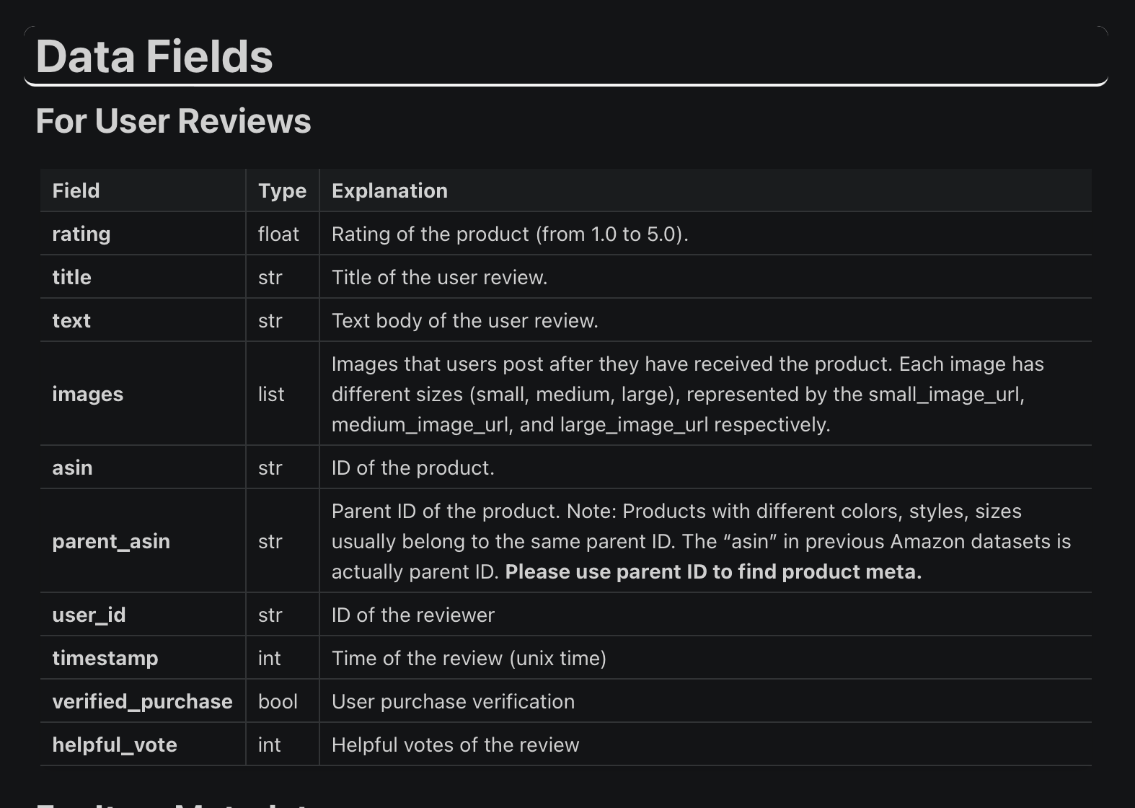
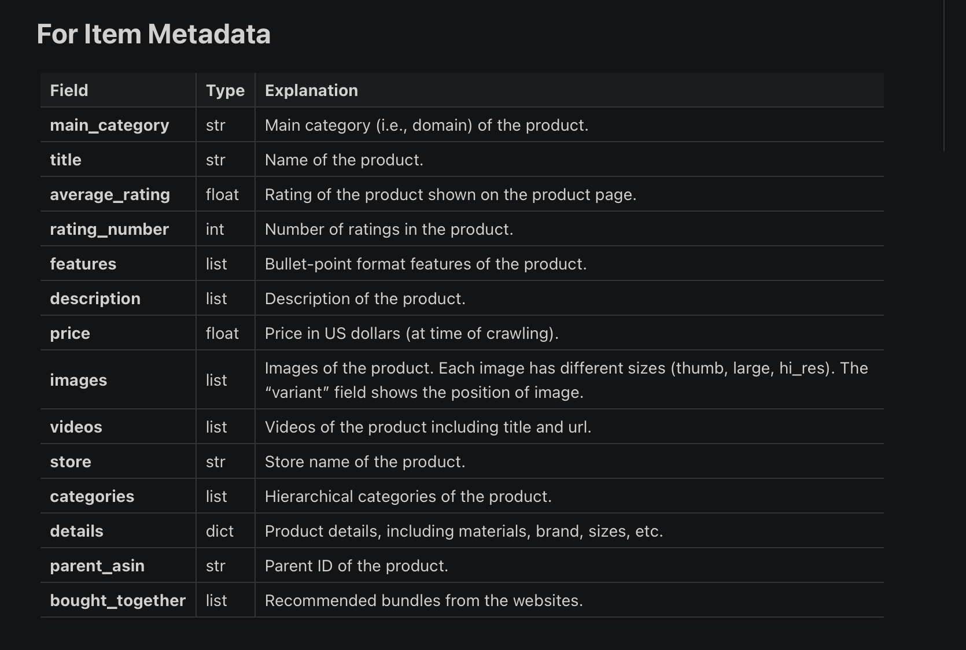
DATASET
SOURCE : https://amazon-reviews-2023.github.io/
Both Files were initially in jsonl format, Converted to Pandas Dataframes for easier Manipulation

Slide 3
BUSINESS PROBLEM
Predict Ratings from given User Reviews (No Latency Constraints) (Accuracy Highly Important)
Ratings tab is usually present with the reviews text tab, Importance?
Due to Logistical issues, ratings might be low even though product was satisfactory (Delivery Times, Specific Stores)
Avoids the Situation of Sparse Ratings
Machine learning can help detect unusual patterns or anomalies in ratings. For example, a sudden influx of low ratings with positive reviews might indicate a coordinated attack or spam.
Businesses can use predicted ratings to identify highly positive reviews and use them in marketing campaigns, promoting products based on customer sentiment rather than just numeric ratings.
Avoiding situations where reviews are positive but ratings tab has been misclicked
Machine learning can analyze the sentiment in the reviews to provide a more nuanced rating. This can account for mixed feelings expressed in the text, which a simple numeric rating might not capture.

Slide 4
RESEARCH QUESTIONS
How well do Deep Learning Models perform on very Limited vocabulary on Data?
What is the performance increase observed when we use Transformer Architectures over hyper-parameter tuned simple feed forward Neural Networks for NLP Tasks?
Exploring the ability of neural-networks to understand relationships between features and target variables better than classical machine learning models when the features dont follow assumptions that classical machine learning models hugely benefit from

Slide 5
Preprocessing and EDA
Dropped [‘images’,’videos','categories','features','description','main_category','bought_together'] from metadata due to high number of missing values
Check For Unique Values across Metadata and Main DataFrame
Flattened ‘Details’ column in metadata which consisted of nested Dictionaries
Mean Imputed Price, Since distribution of Price was Heavily centered around the Mean
60k Unique Metadata Product IDS, 465k Unique Main df rows.
~400k unique users who have reviewed 60K Products
Check and Removal of Duplicate Rows
Merged both Dataframes on Product ID

Slide 6
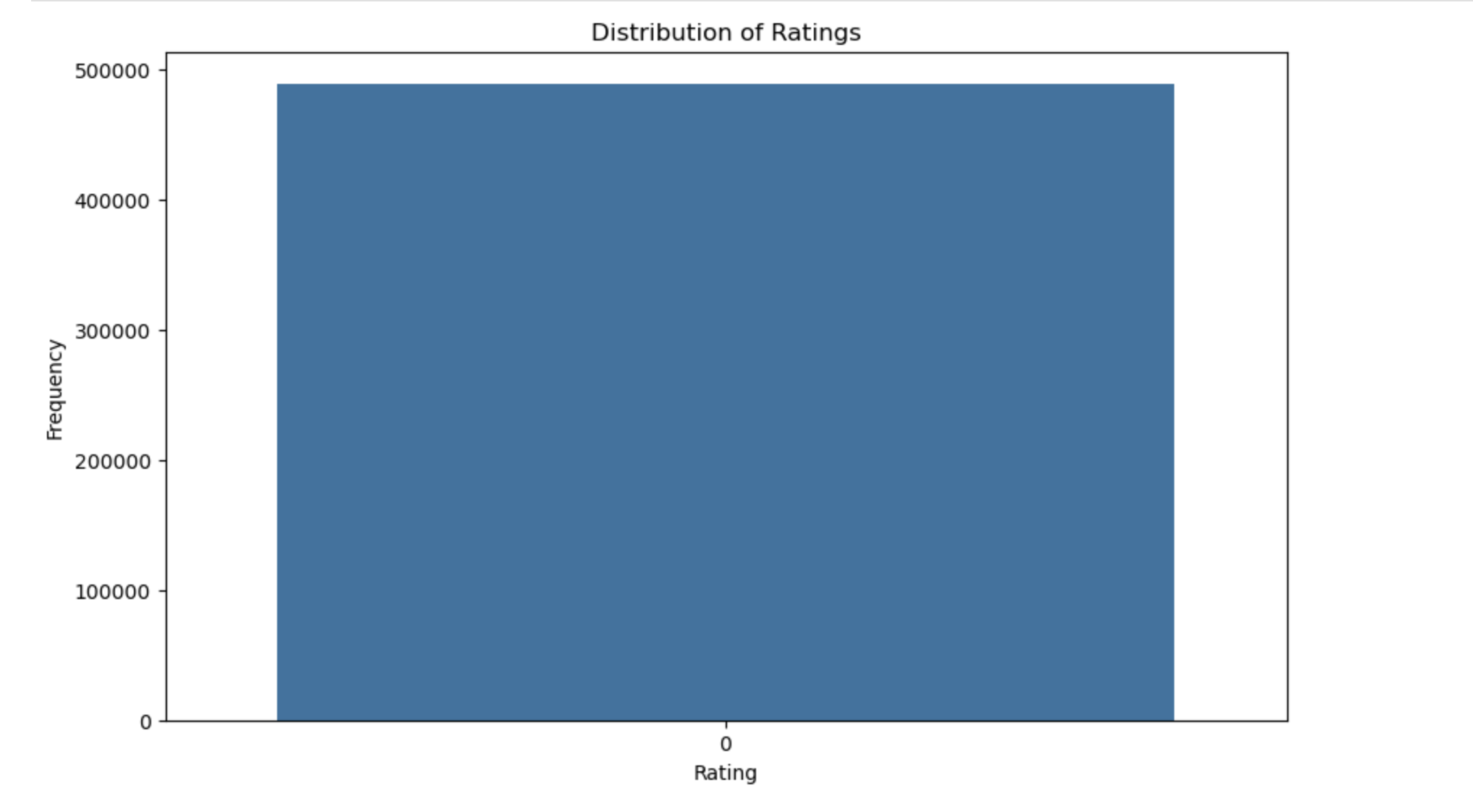
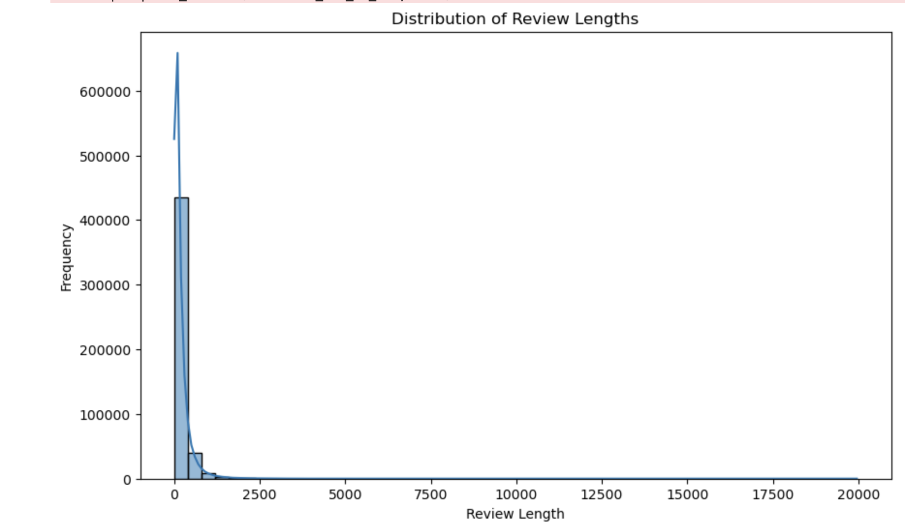

PLOTS

Slide 7
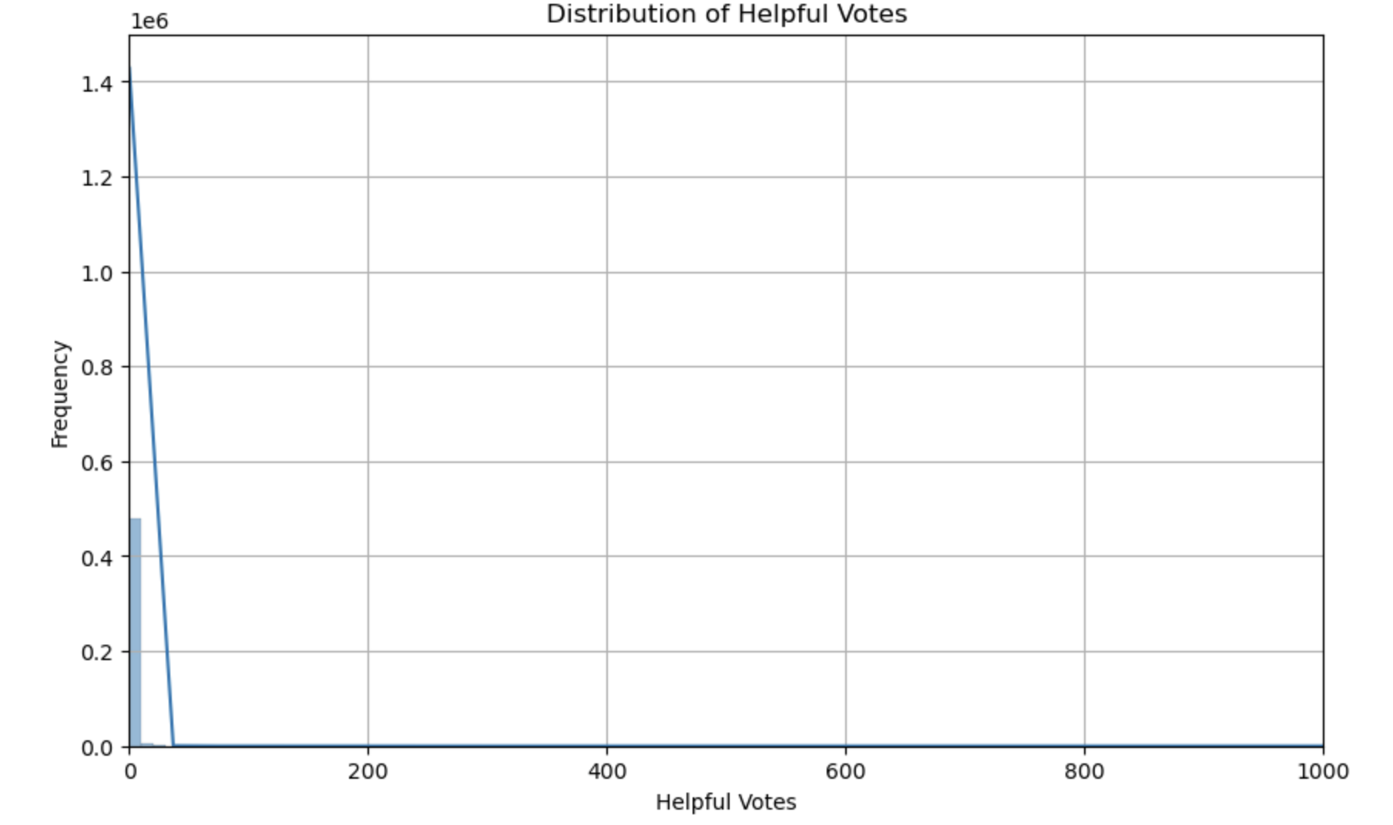
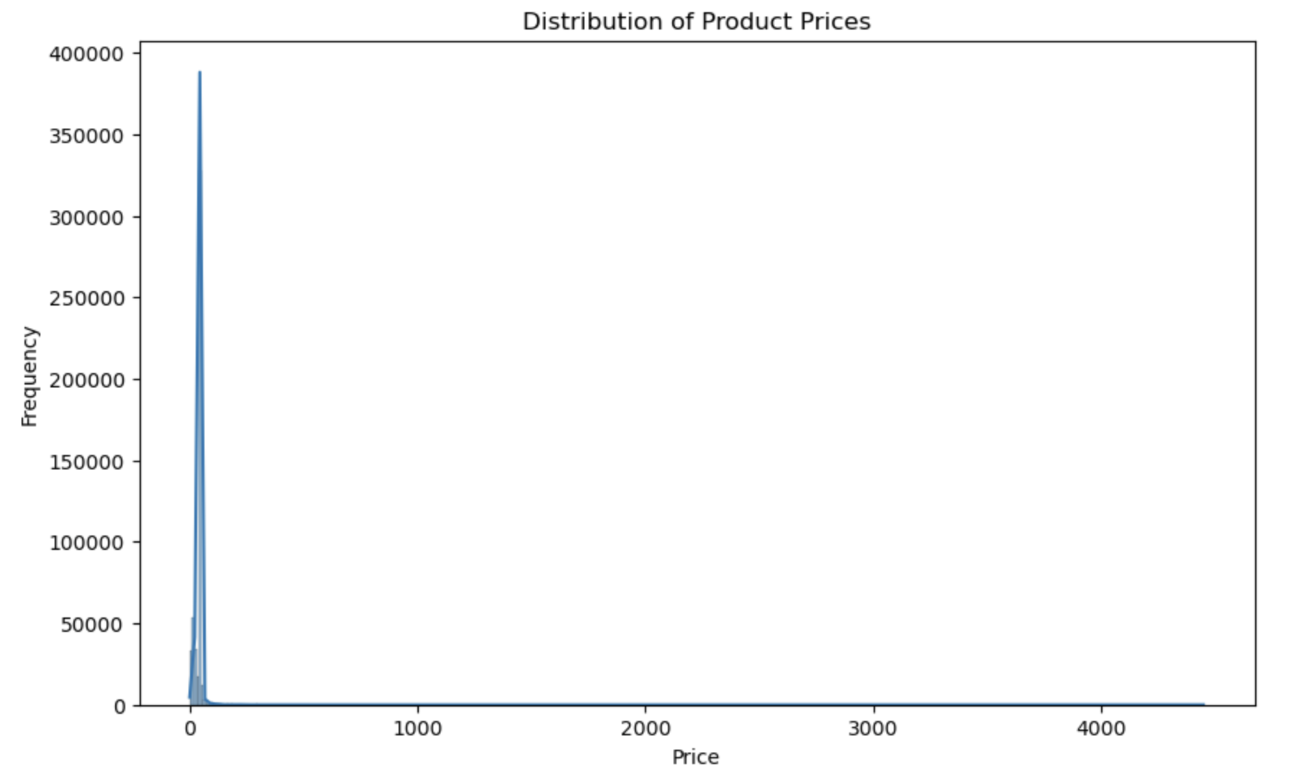
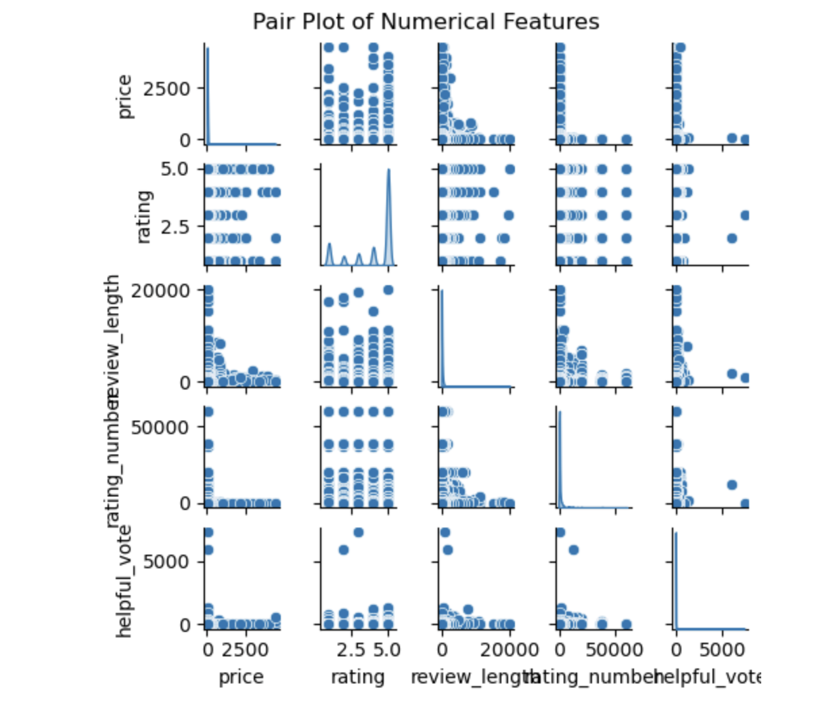
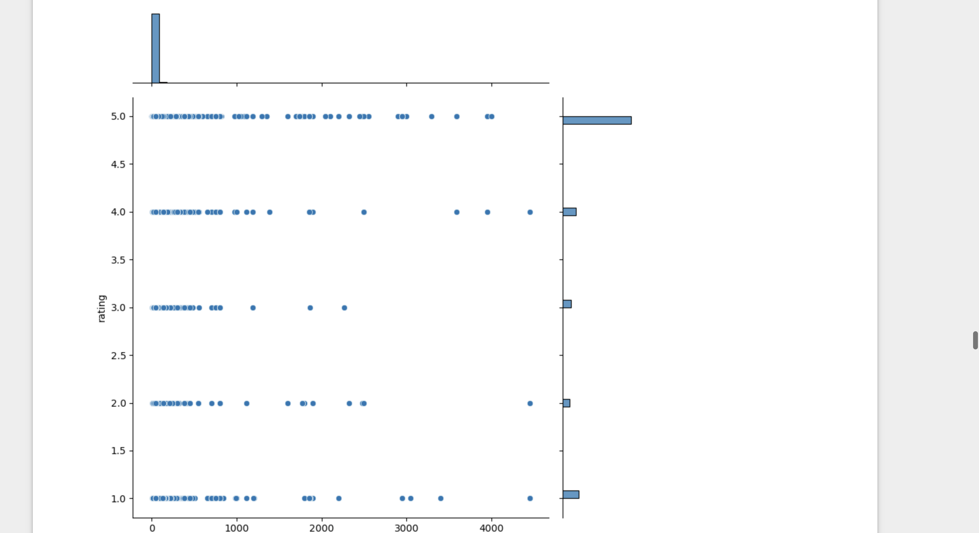
Class
Imbalance
Observed

Slide 8
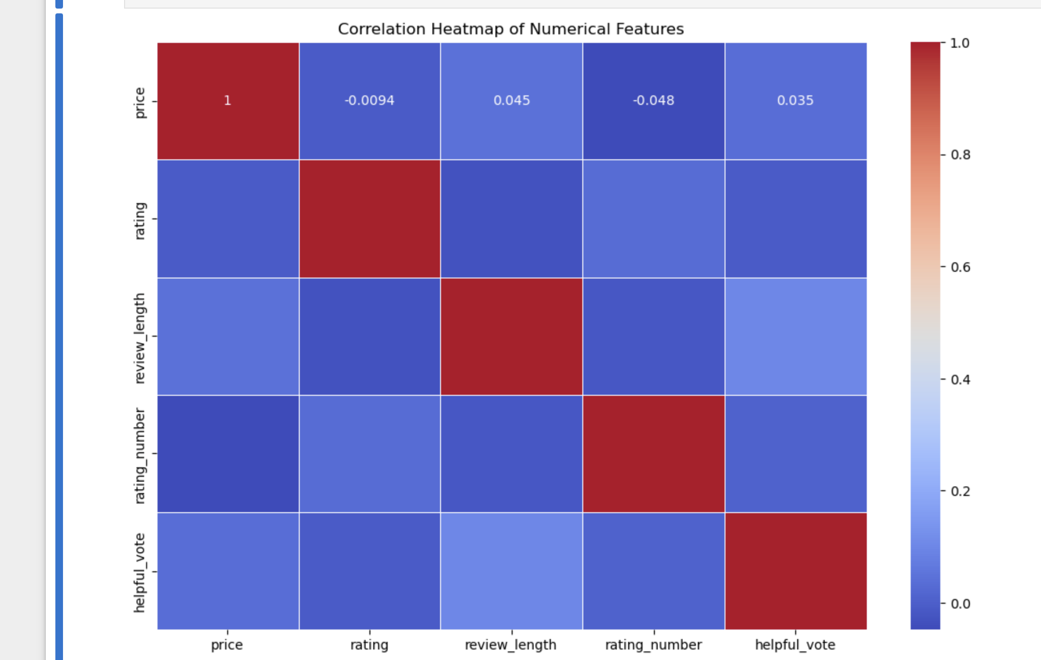
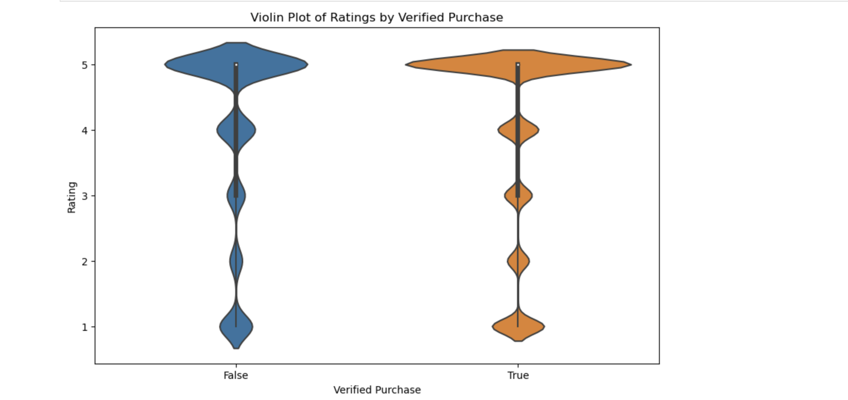
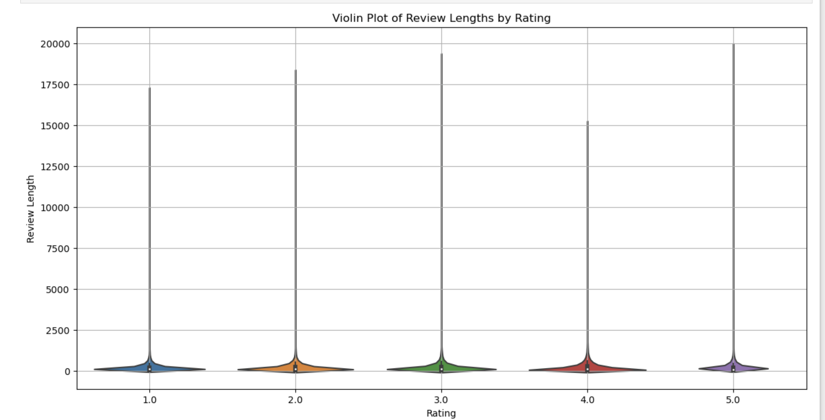

Slide 9
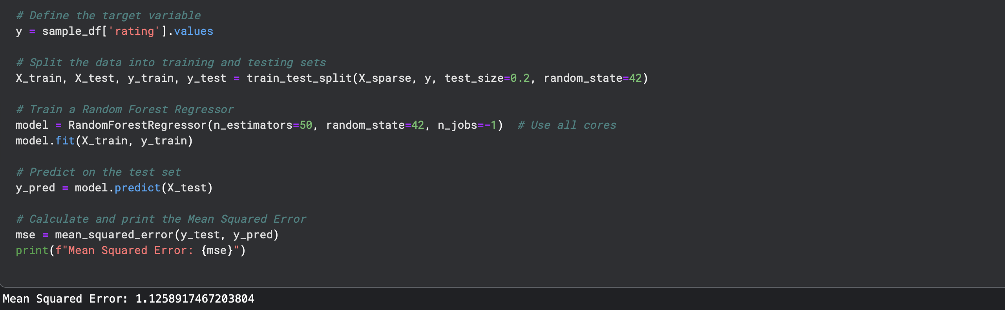
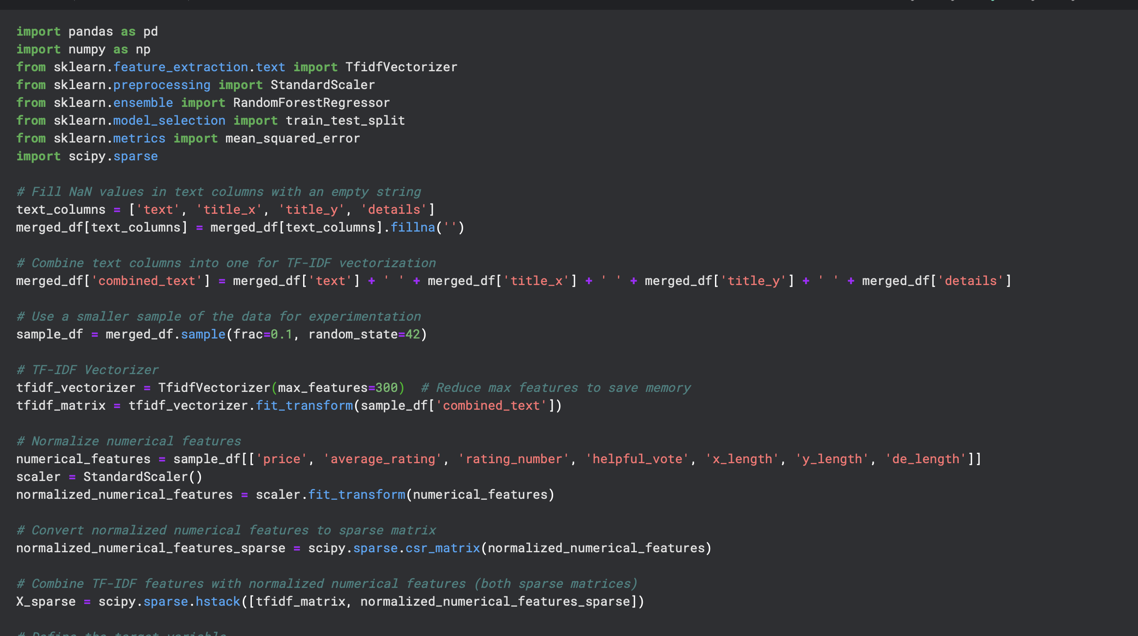
Feature Engineering & BaseLine Model
Added New features : Review Length, Details Length, Titles Length

Slide 10
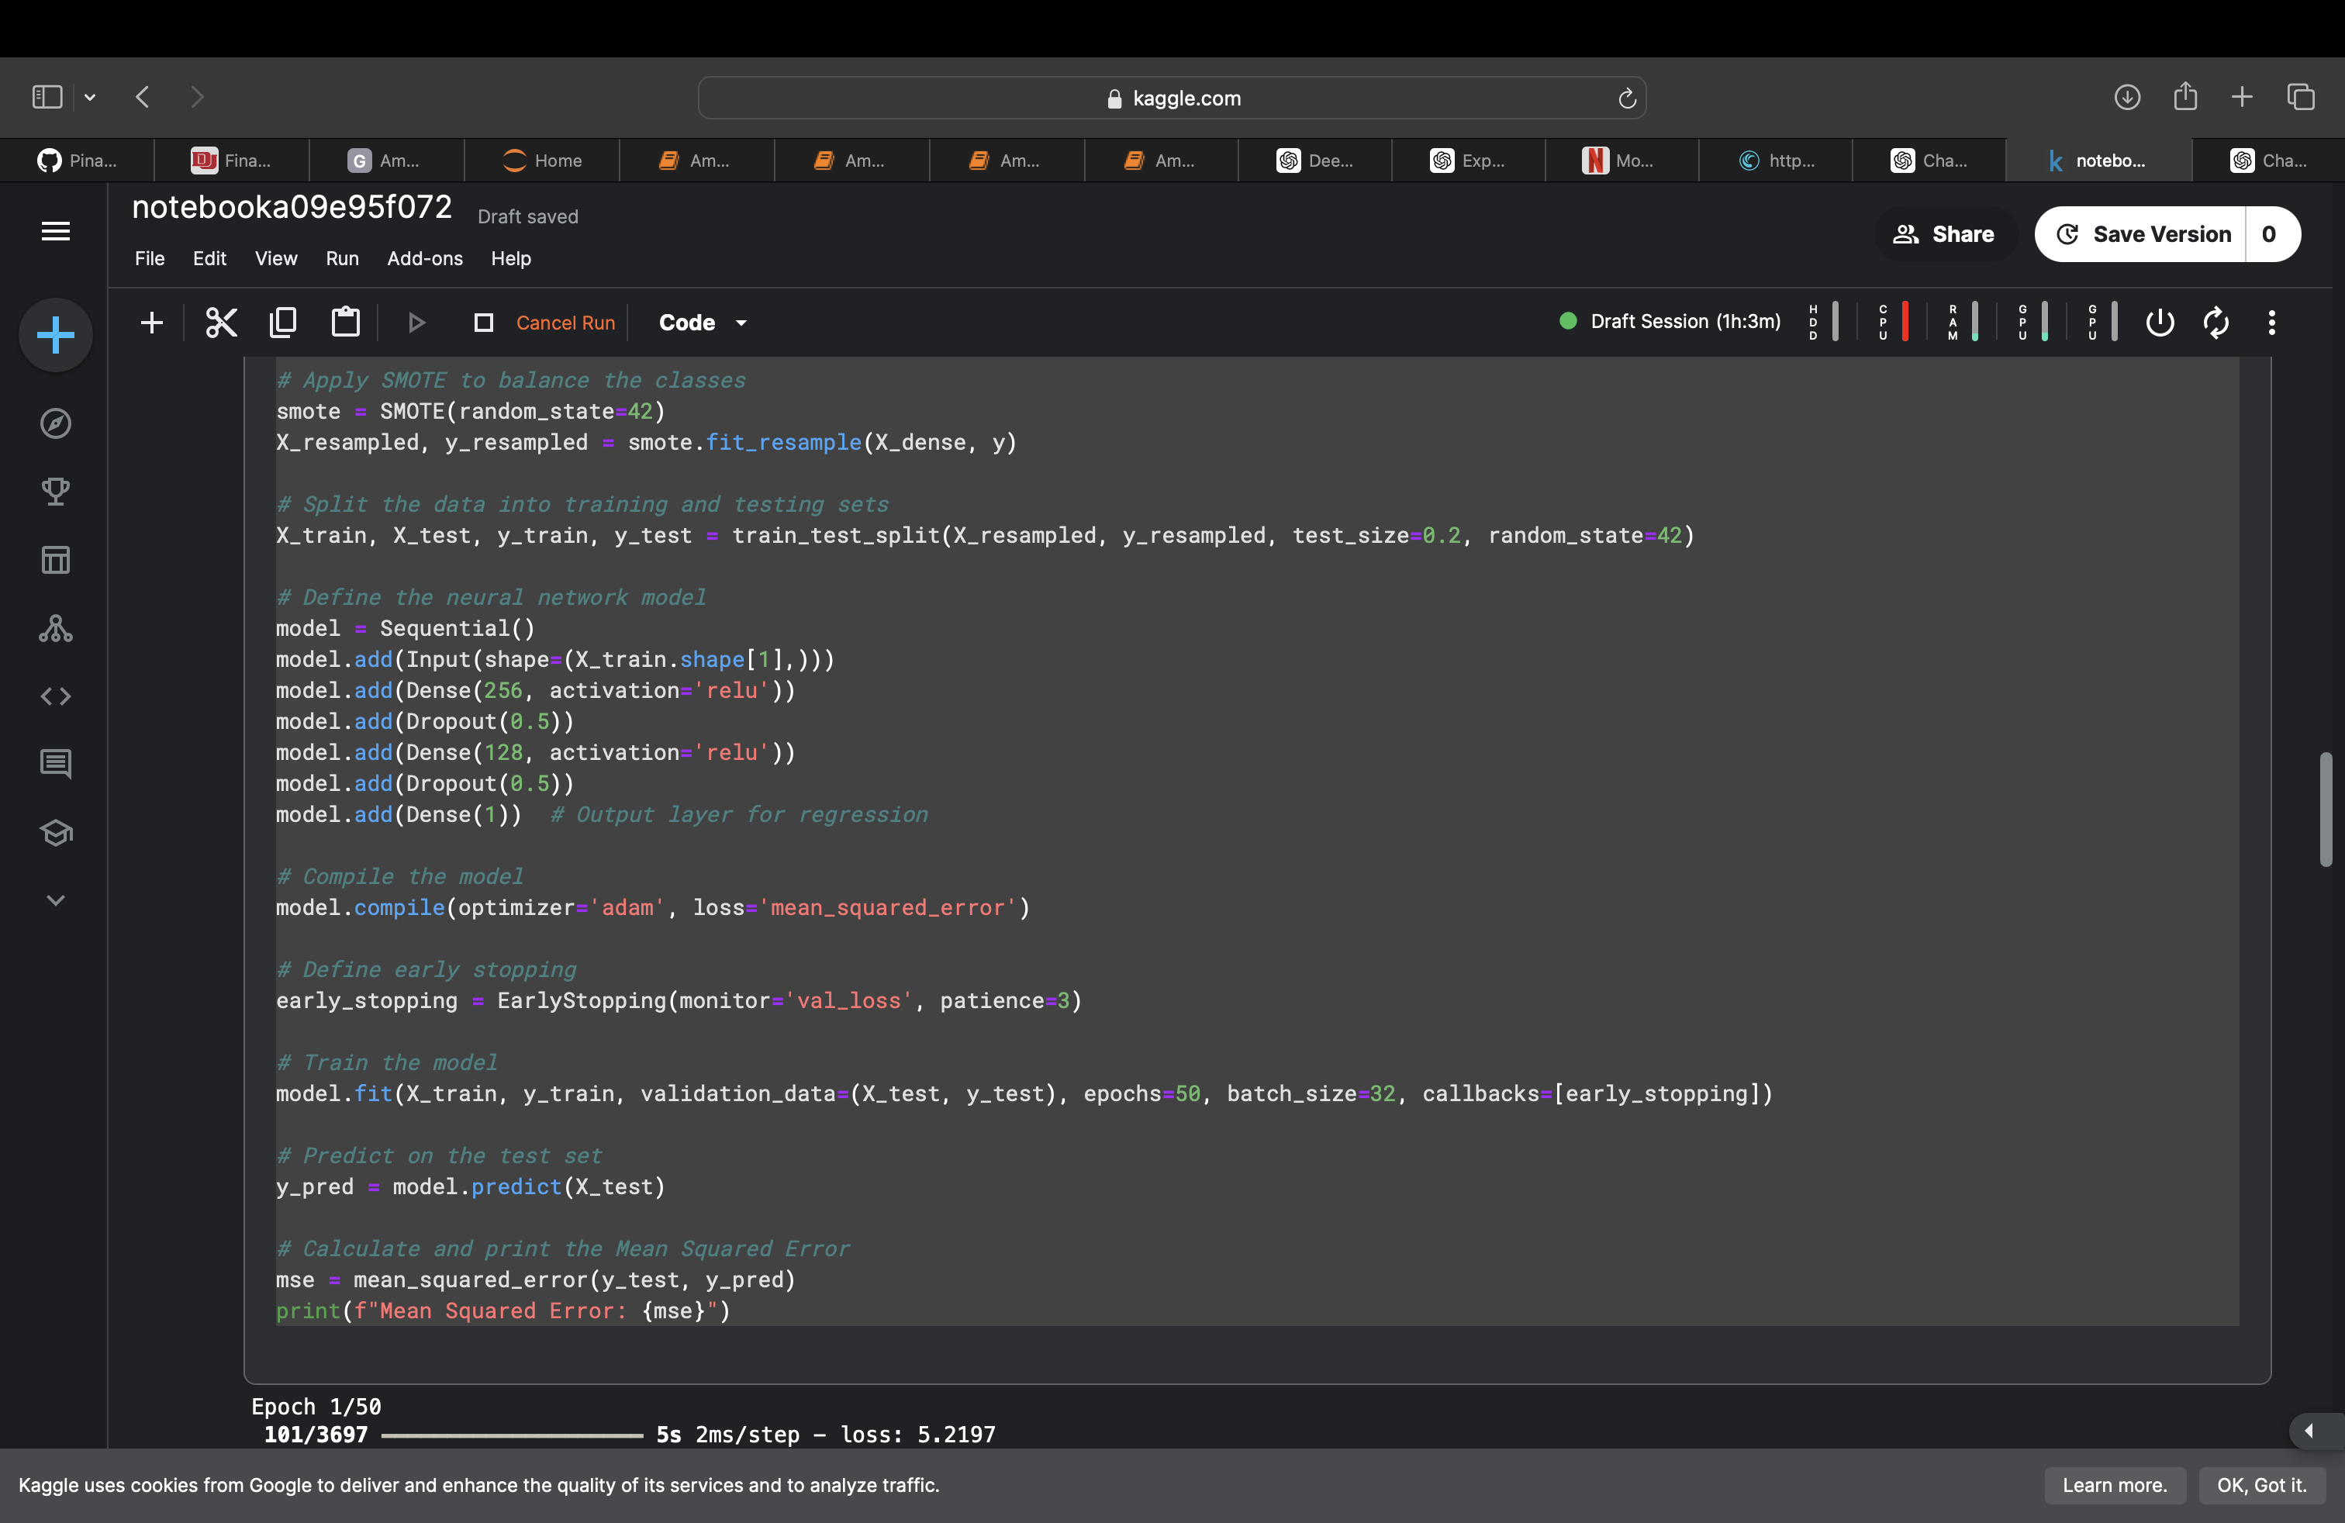
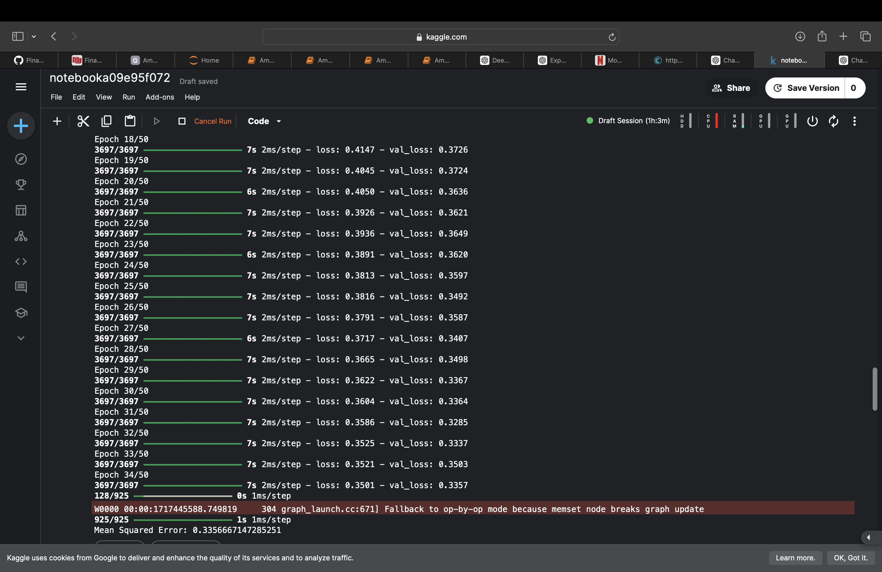
Feed Forward Network

Slide 11
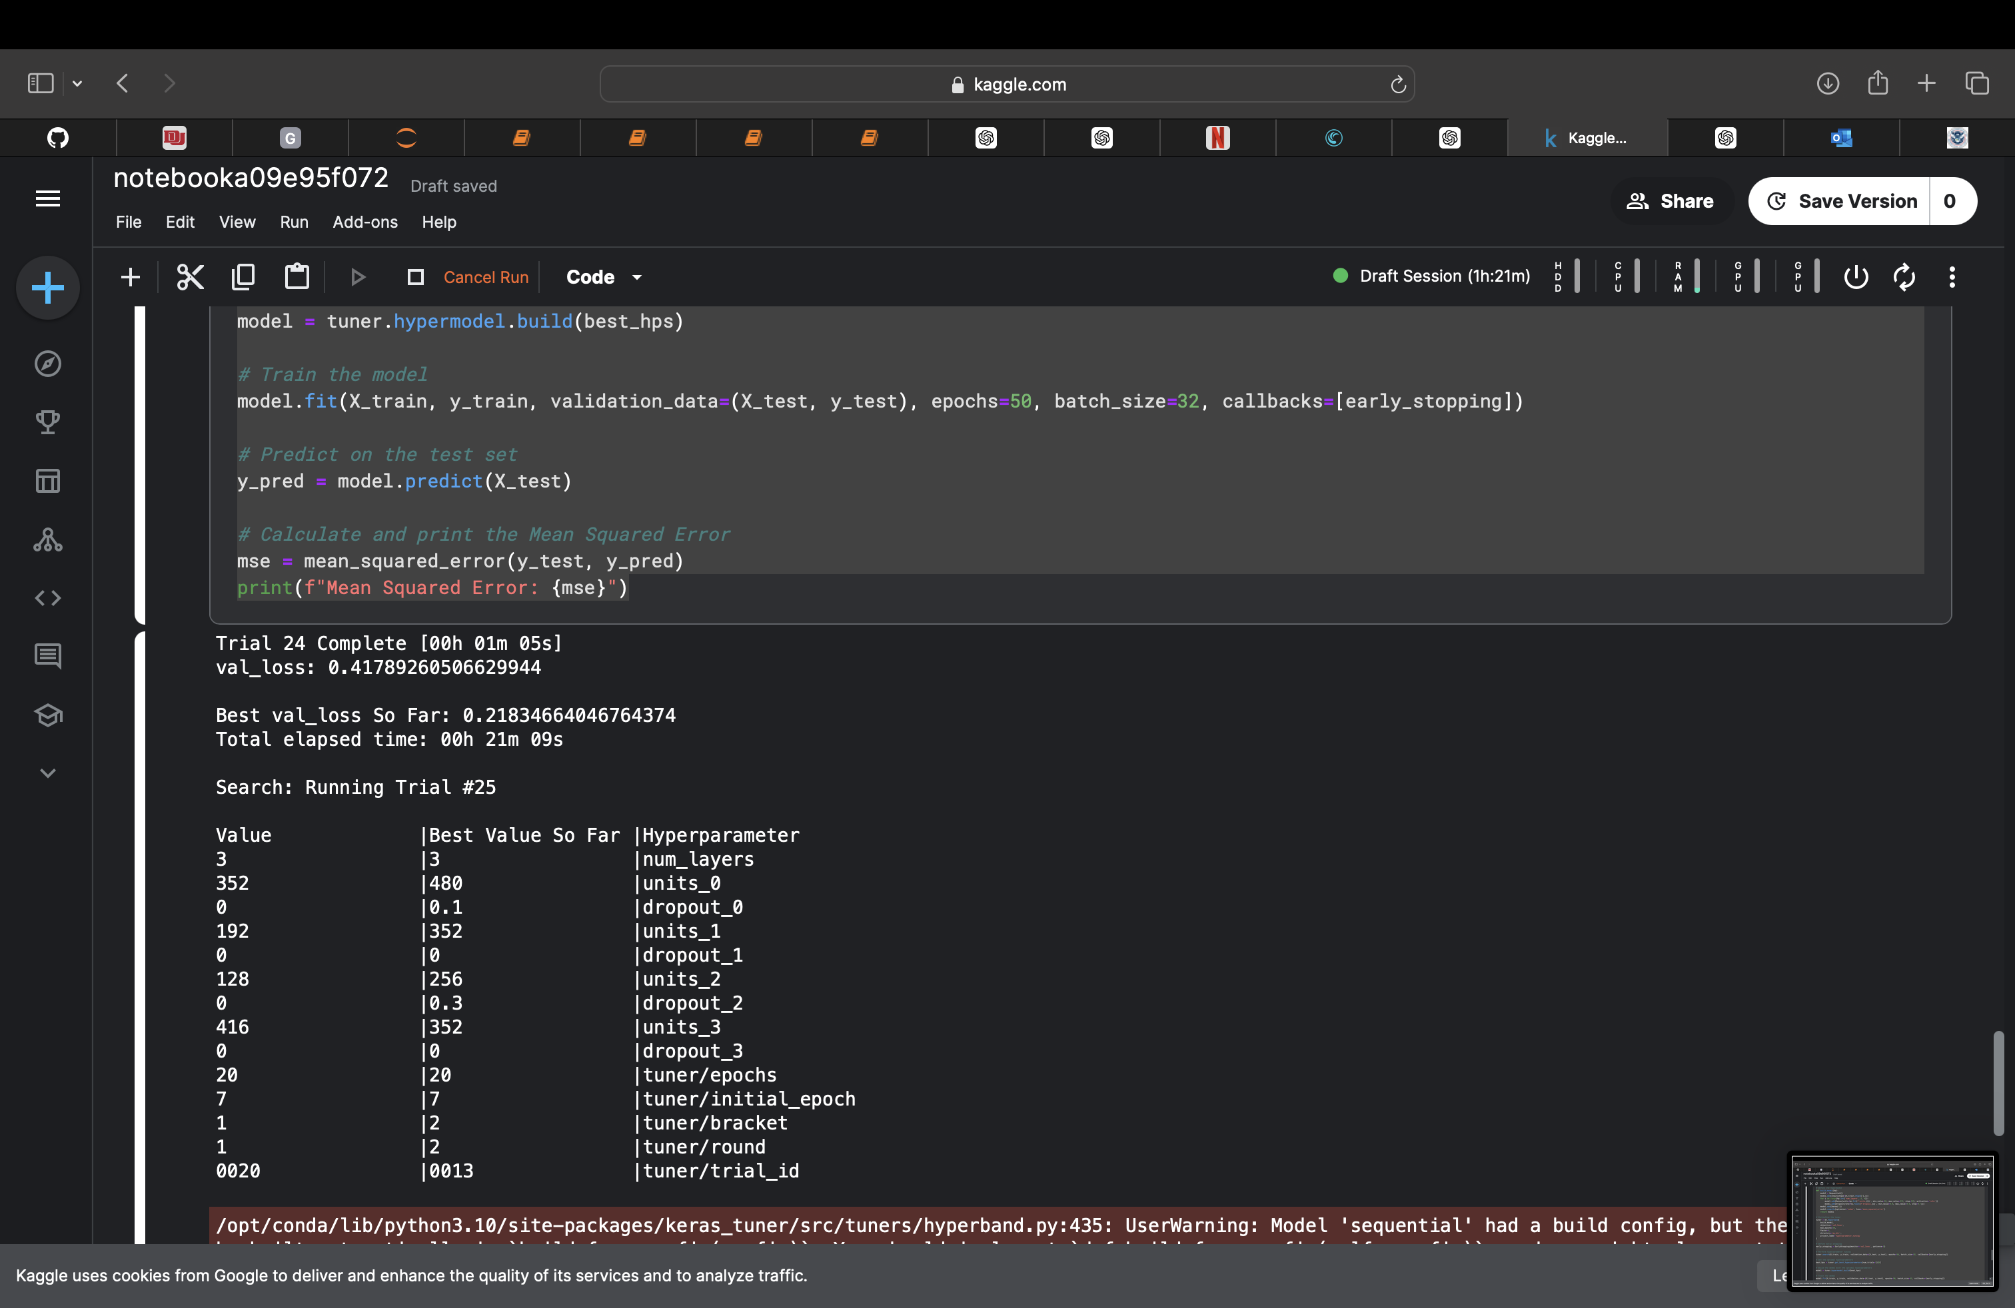
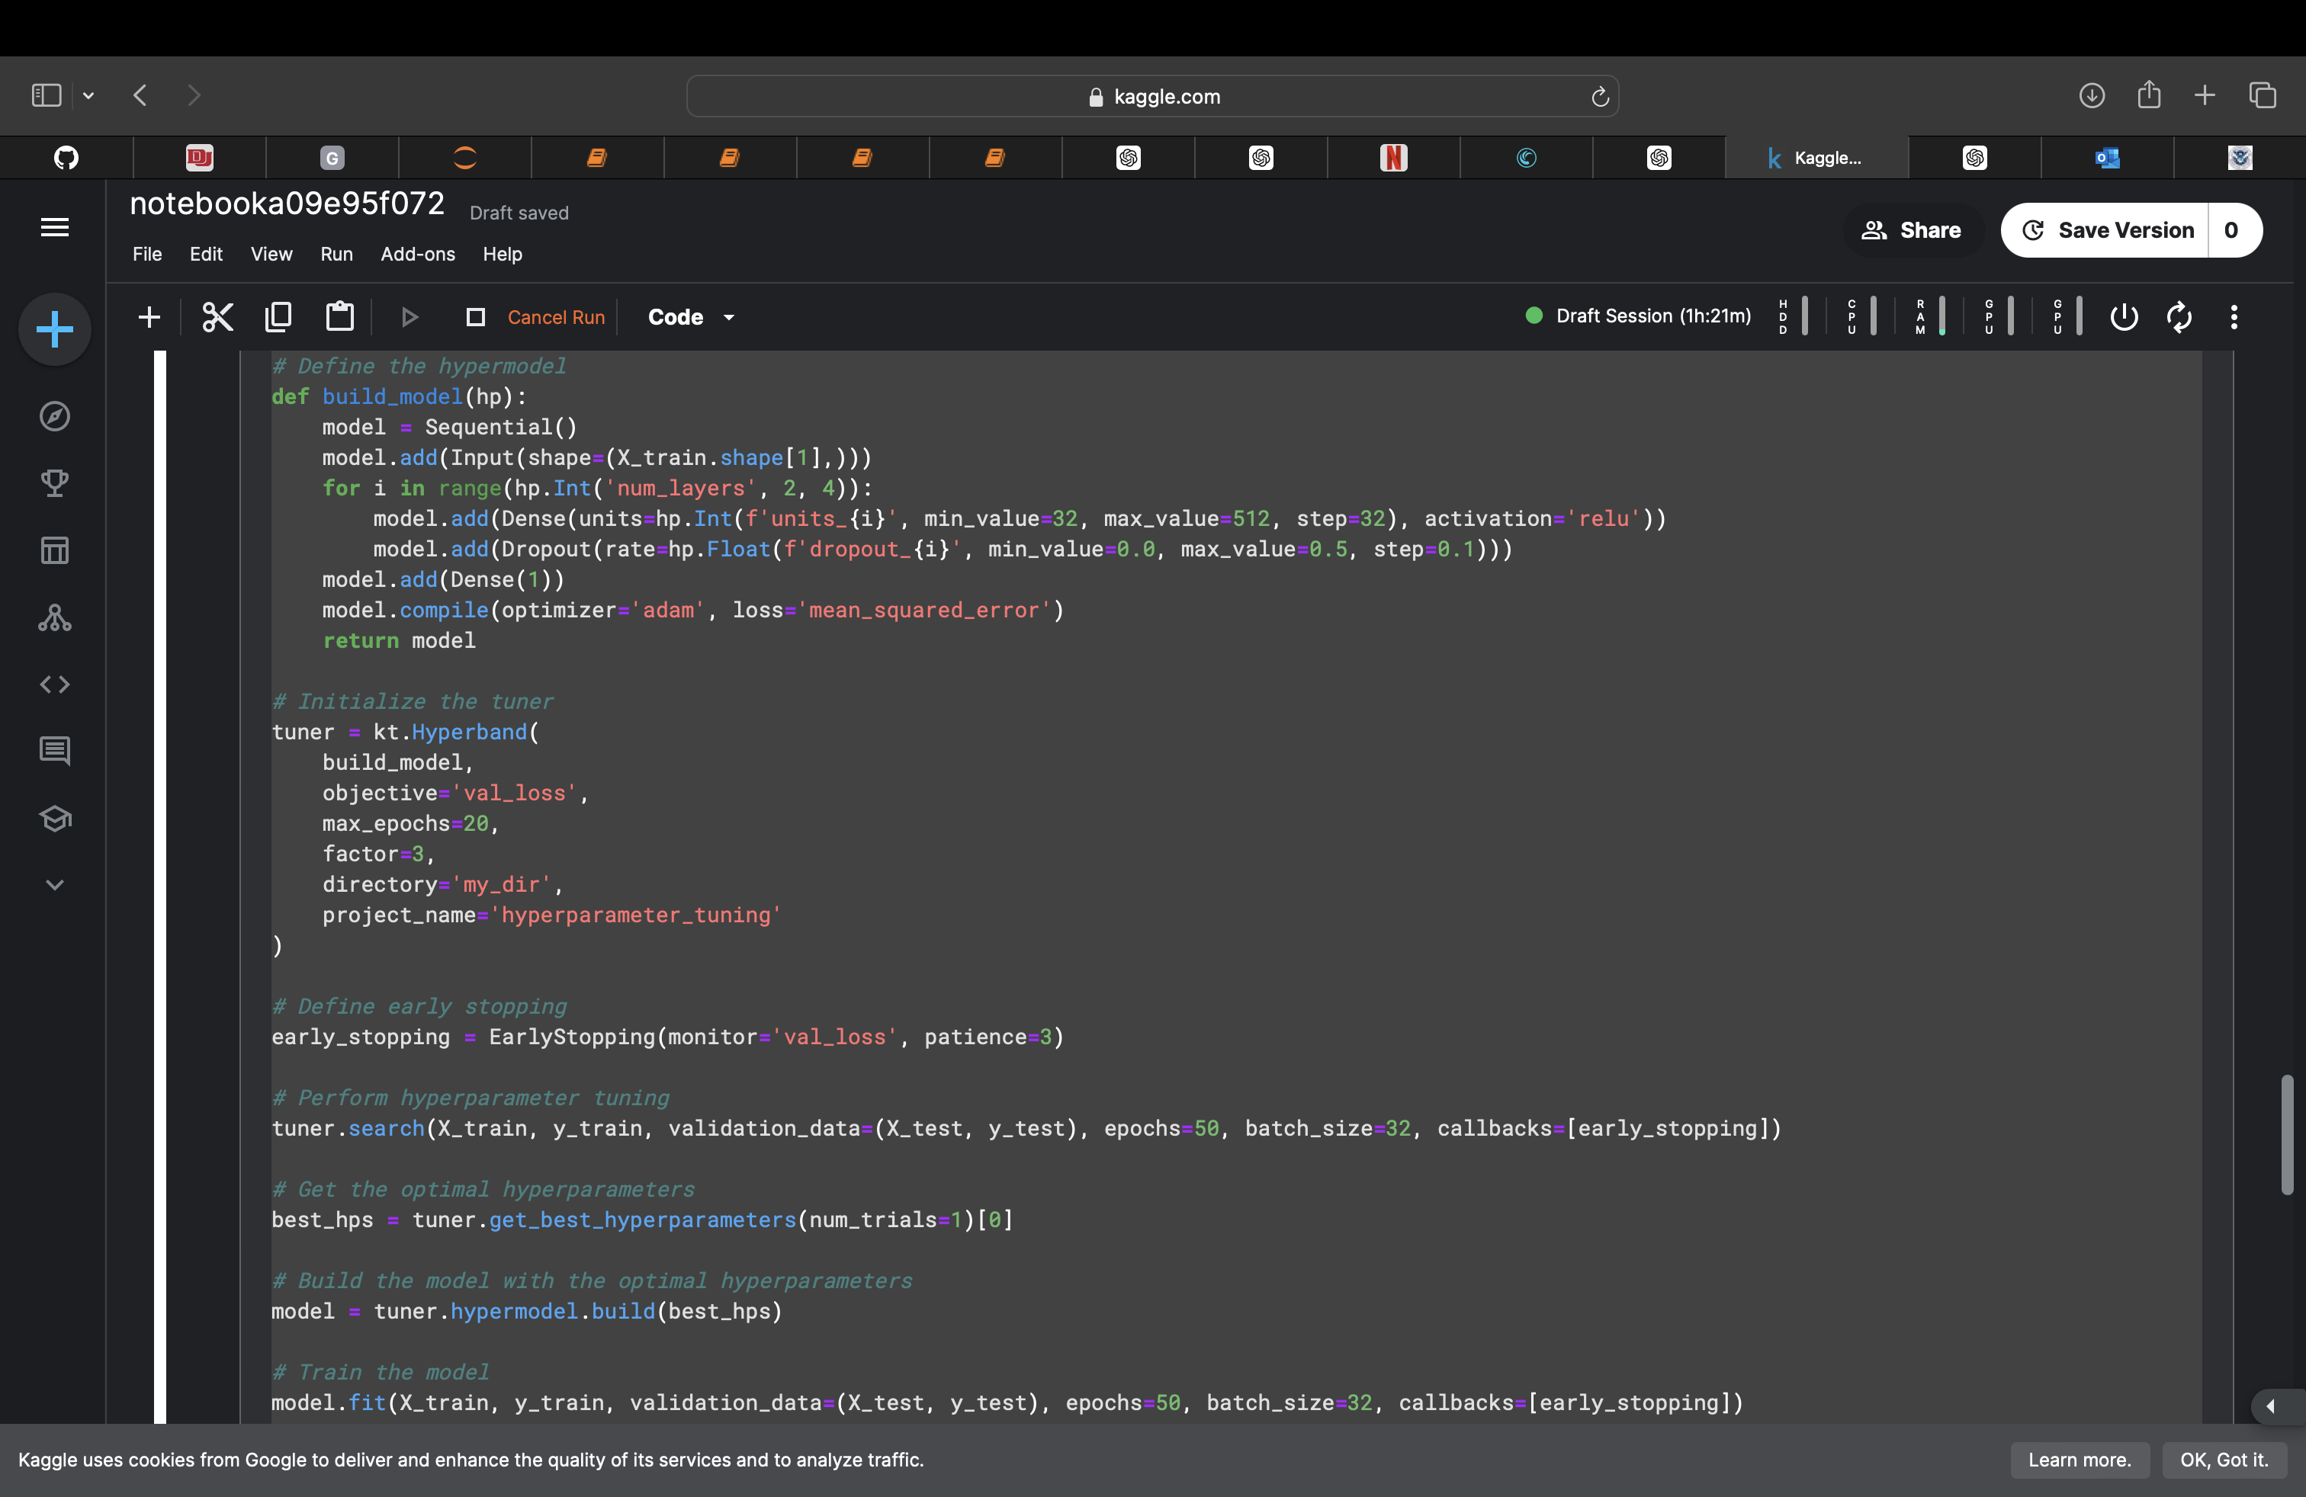
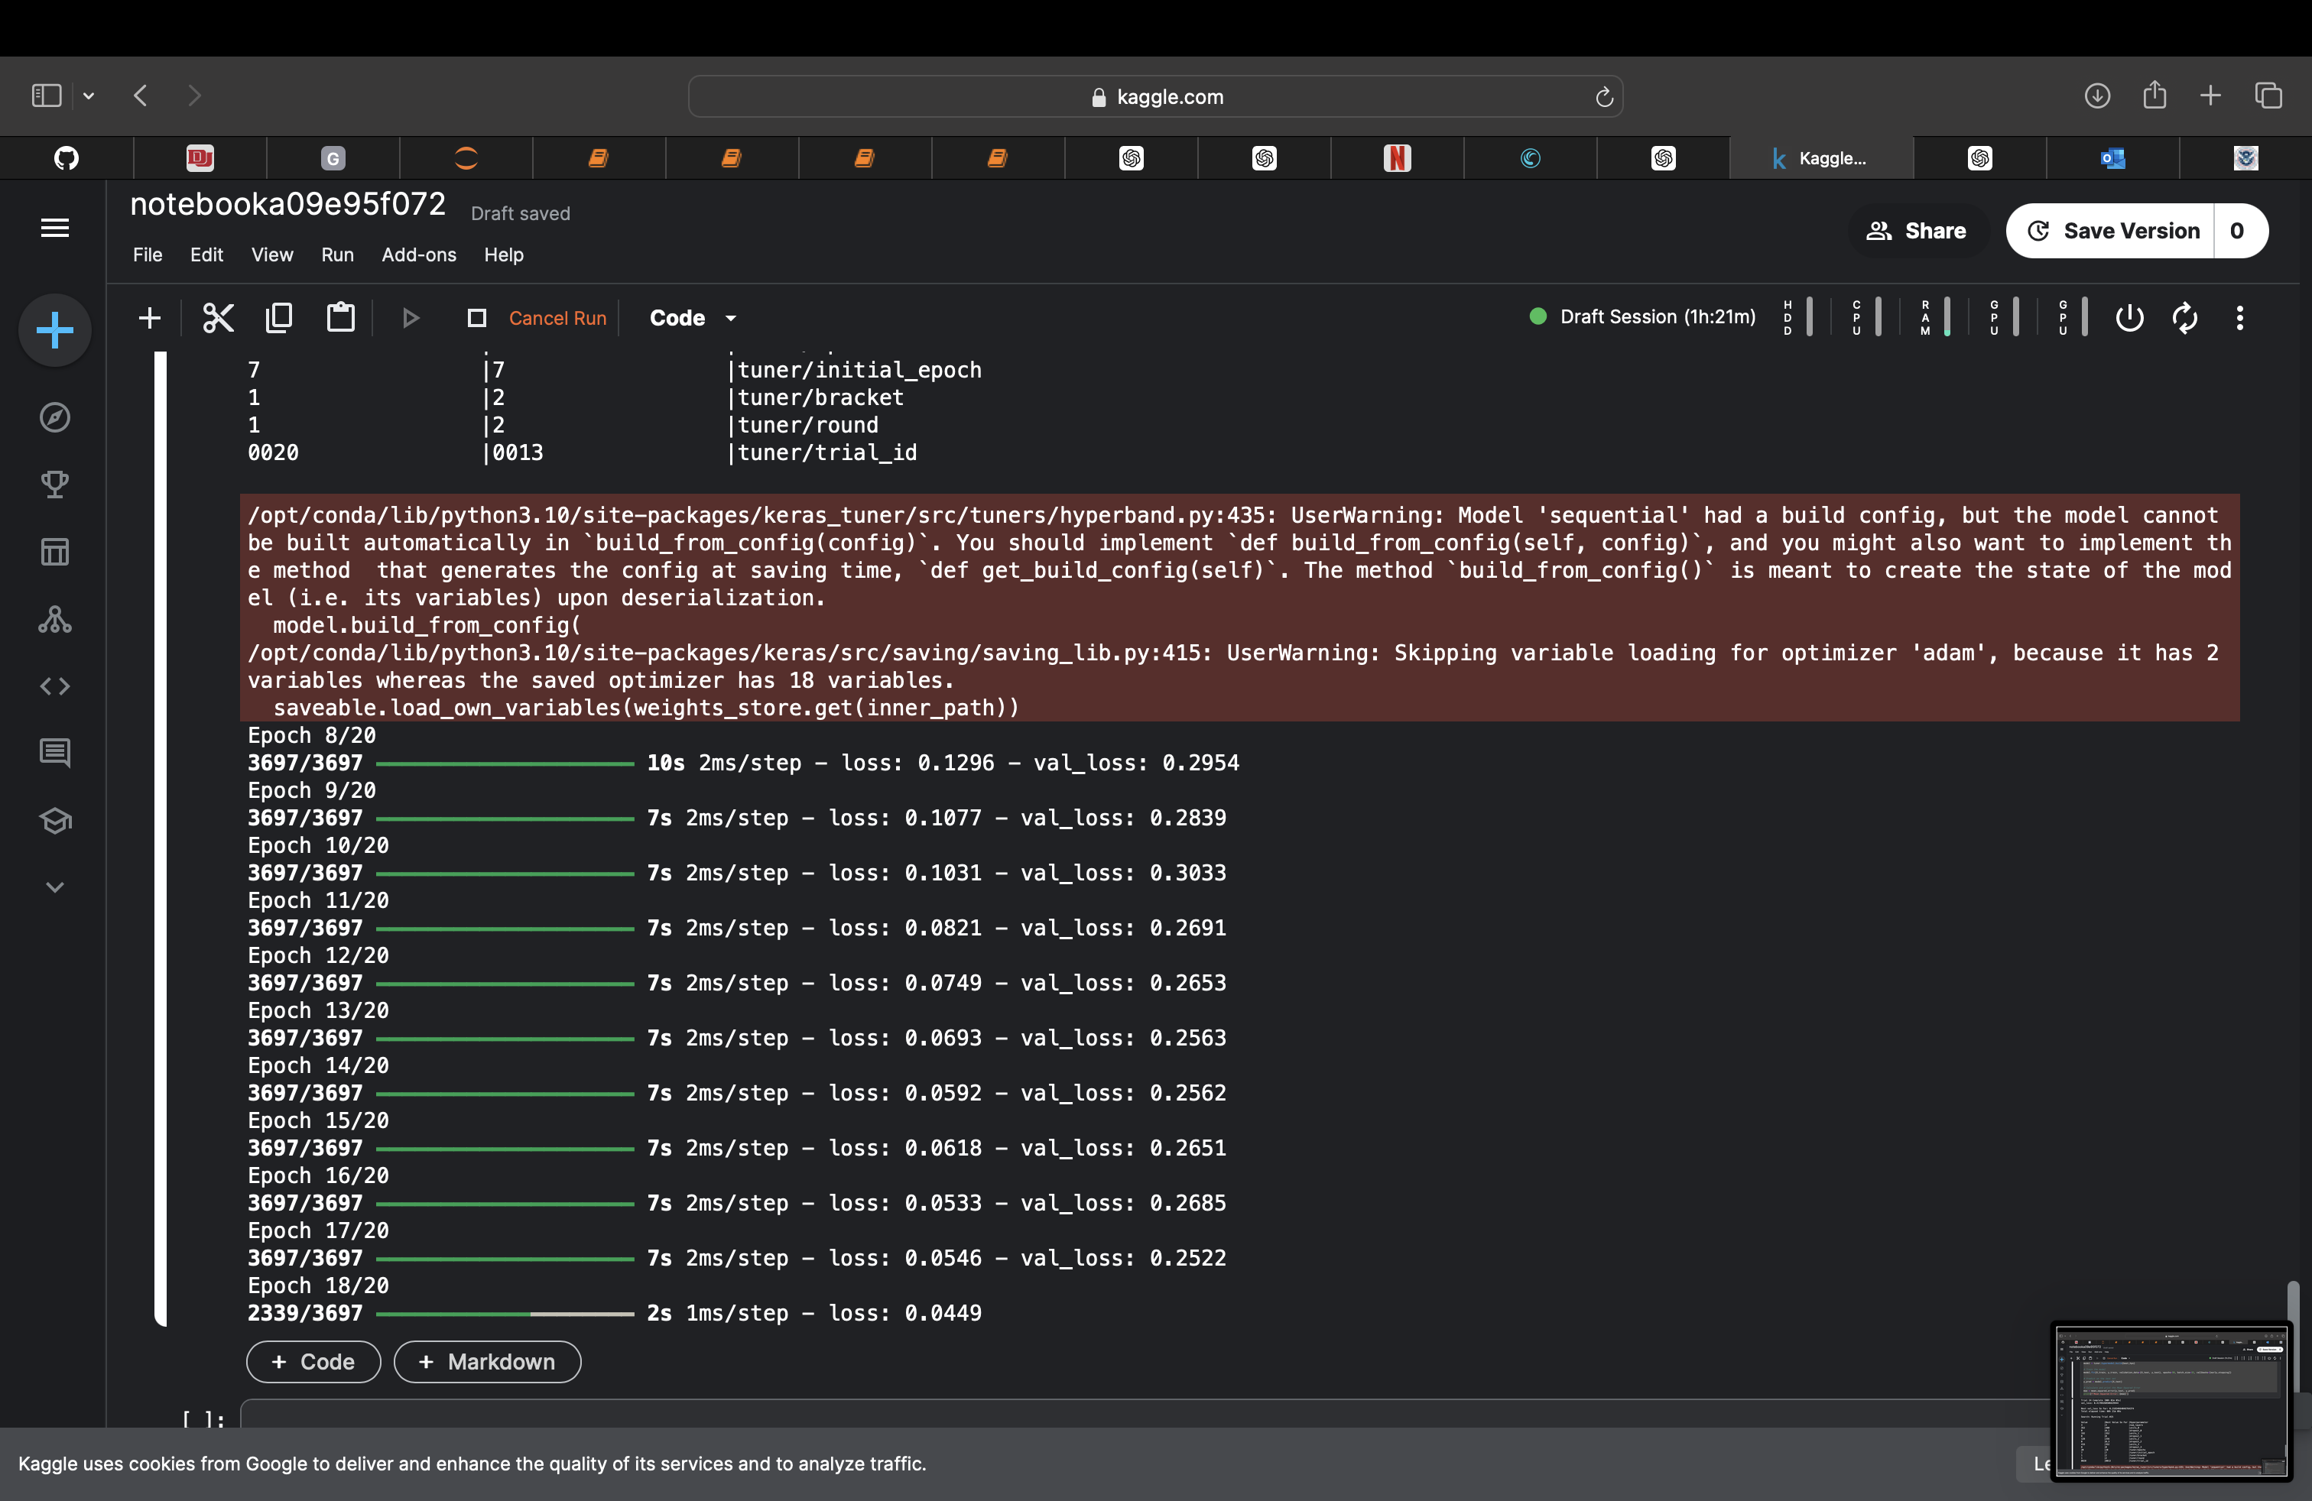
Hyper-Parameter Tuned

Slide 12
High level Description
Data Preparation: Filled NaNs in text columns, combined text columns into combined_text, and sampled 10% of the dataset.
Normalization: Standardized numerical features using StandardScaler.
Data Splitting: Split data into training and testing sets for both text and numerical features.
Dataset and DataLoader: Created ReviewDataset class to tokenize text and combine it with numerical features; used DataLoader for batch processing.
Model Definition: Defined TransformerRegressor to integrate BERT's text embeddings with numerical features and a linear layer for regression.
Training and Evaluation: Trained the model using train_epoch, evaluated with eval_model, optimized with AdamWand a learning rate scheduler, and saved the best model state based on MSE.

Slide 13
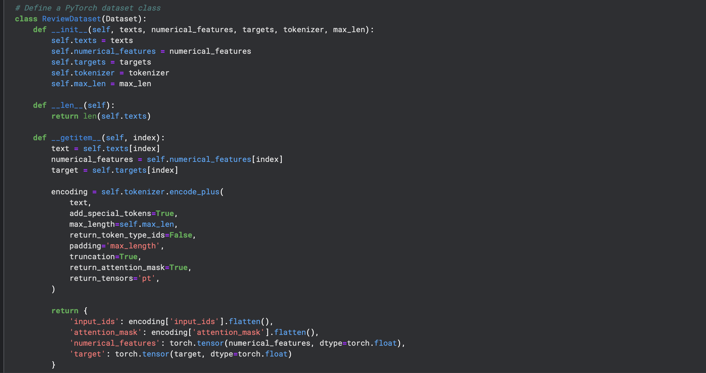
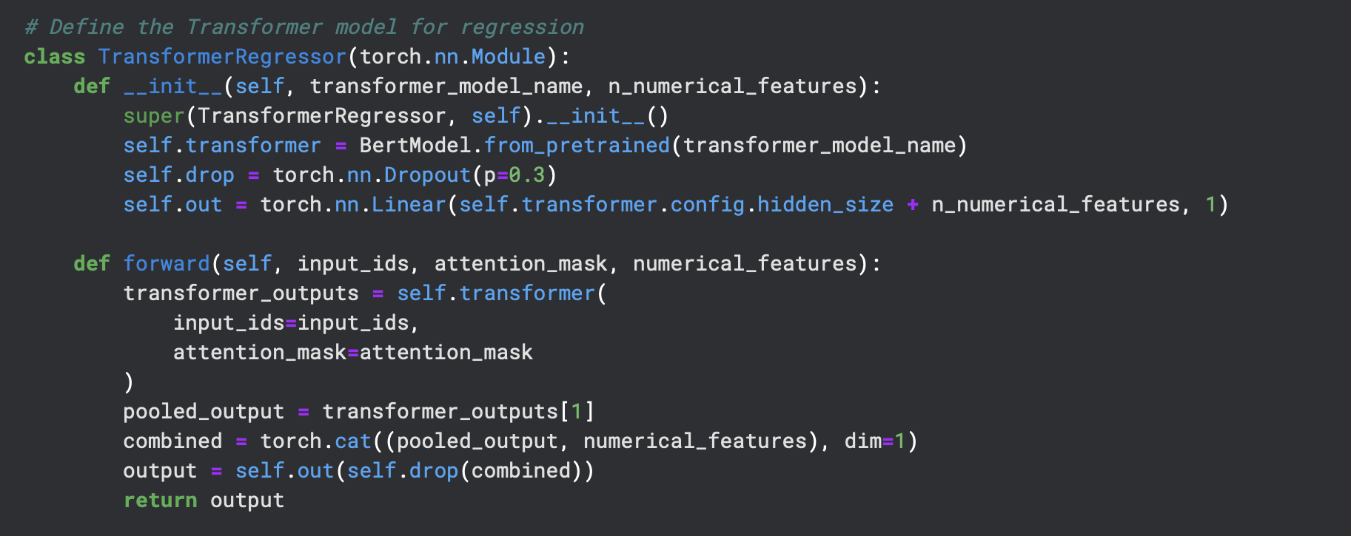
Transformer fine-tuned for Regression

Slide 14
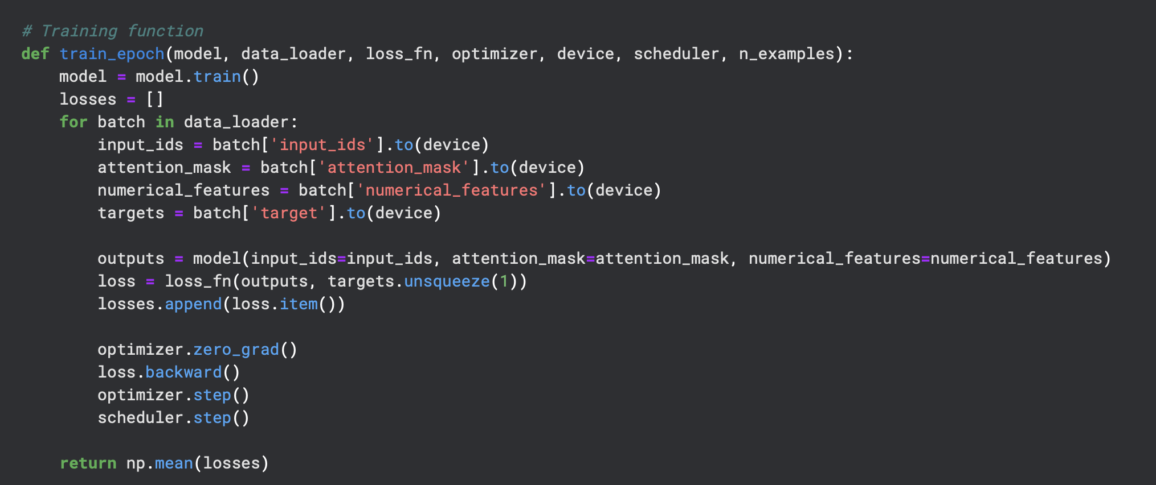
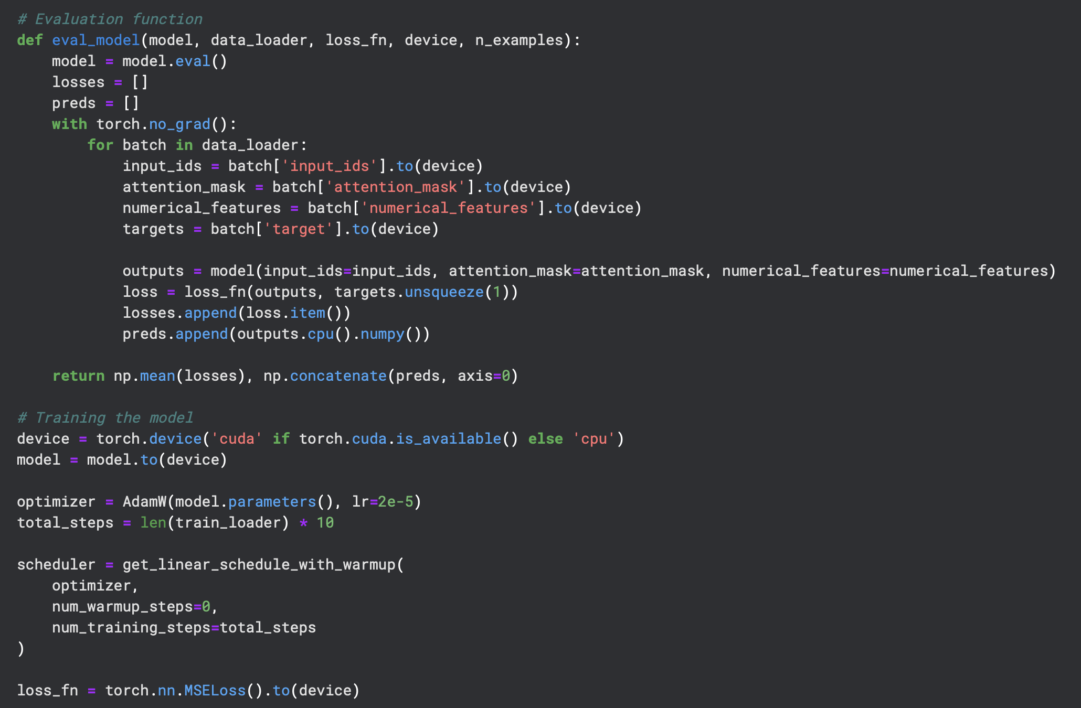
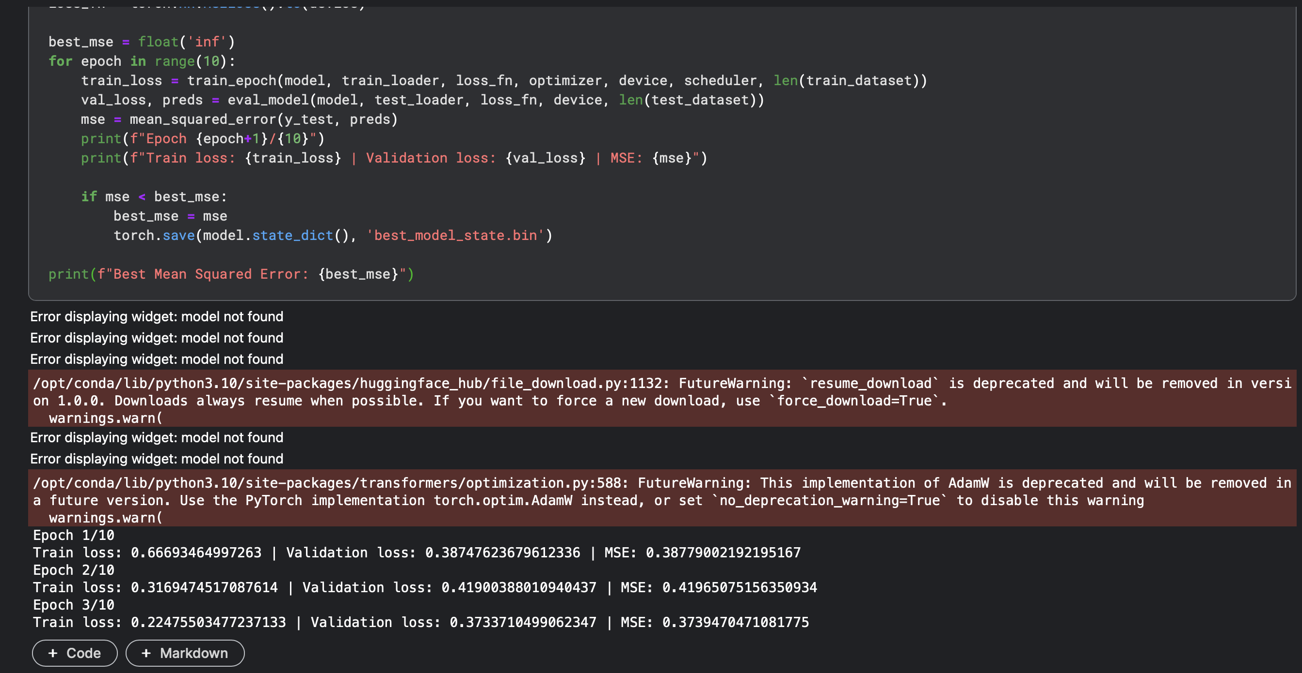

Slide 15
RESULTS
RANDOM FOREST MSE : 1.12
NN MSE : 0.33
Hyper-Parameter Tuned NN : 0.0449
Transformer : ~0.22 After 10 Epochs

Slide 16
Conclusion
Data Size and Quality: BERT requires large datasets to fine-tune effectively, whereas TF-IDF can perform well on smaller datasets.
Model Complexity: BERT's complexity can lead to overfitting on small datasets, while a simpler TF-IDF model can generalize better.
Feature Integration: TF-IDF may be integrating numerical features more effectively than current BERT setup.
Task-Specific Adaptation: BERT's pre-training might not align well with your specific task, making TF-IDF more suitable.
Simplicity vs. Complexity: Simpler models like TF-IDF can sometimes outperform complex models like BERT, especially if the latter does not add significant value to the problem.

